Slide 1
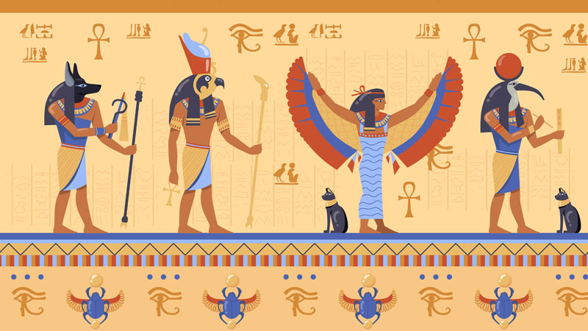
Social/Political Structures
GOAL/S: Describe Ancient Egyptian Social/Political Structures
Week 9, Lesson 1

Slide 2
Watch the following
https://www.youtube.com/watch?v=ocnA58Vg-L0&ab_channel=A.J.Merrick

Slide 3
Ancient Egypt – This week
Social/Political Structures
Economic Structures
Religious/Cultural Structures

Slide 4
During the New Kingdom period of Ancient Egypt (circa 1550–1070 BCE), the social and political structures were characterised by a hierarchical and centralised system. At the top was the pharaoh, who was considered both a divine ruler and the supreme political authority responsible for maintaining Ma'at (order, justice, and harmony). The pharaoh was supported by high-ranking officials, including the vizier, who managed the administration, and a class of nobles and priests who held significant power and land. Scribes and artisans played vital roles in record-keeping and the creation of cultural artefacts, while the majority of the population consisted of commoners and farmers who produced food and paid taxes in labour and produce. Although slaves existed, they were not as central to the economy as in other ancient civilisations. This intricate system of social stratification and governance allowed the New Kingdom to achieve remarkable political stability and cultural prosperity.

Slide 5
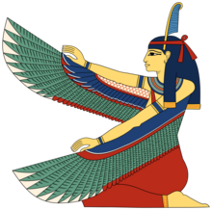
Ma’at
KEY TERM
The personification of truth, justice, and the cosmic order.
In its abstract sense, maat was the divine order established at creation and reaffirmed at the accession of each new king of Egypt
The daughter of the sun god Re, she was associated with Thoth, god of wisdom.

Slide 6
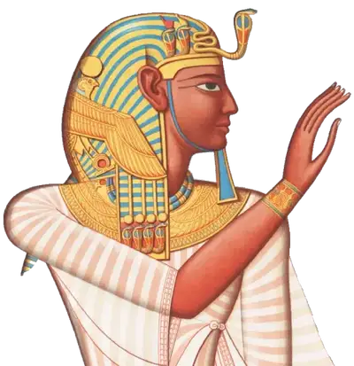
Pharaoh
KEY TERM
Ancient Egyptian rulers, and pharaohs were both the heads of state and the religious leaders of their people.
The word “pharaoh” means “Great House,” a reference to the palace where the pharaoh resides.
What famous Pharaoh’s do you already know of?

Slide 7
ACTIVITY – Egyptian Social Hierarchy
Cut out and glue the hierarchy worksheet into your book
Using the information on the following slides, complete the hierarchy
DISCUSSION QUESTION:
What does the word ‘hierarchy’ mean?

Slide 8
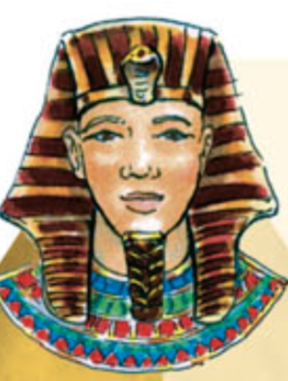
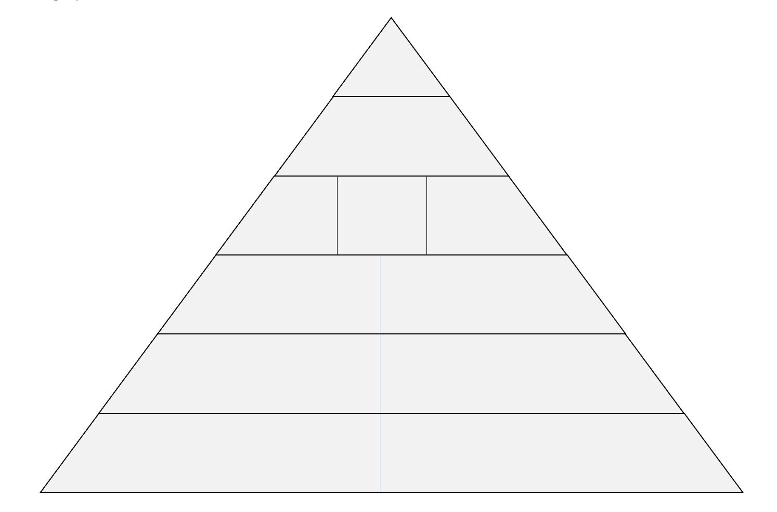
Pharaoh
kept life in balance
was considered a god-king
had great wealth
was the highest priest in the land

Slide 9
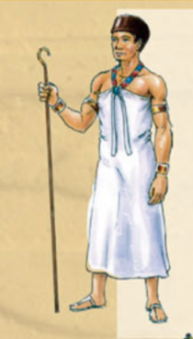
Vizier
Second-in-command
Pharaoh’s main advisor
Supervised other officials
Acted as judge for law breakers
i

Slide 10
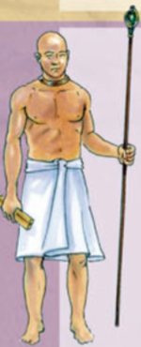
Chief Priest
Represented Pharaoh
Permitted to enter inner temple where statues of gods were kept
responsible for cleaning temple god and bringing it food

Slide 11
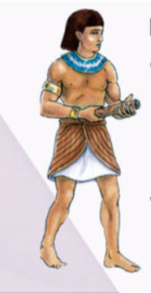
Nobles
Governed smaller regions within kingdom
Collected taxes

Slide 12
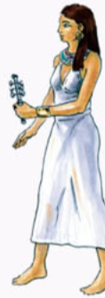
Priestesses
Married to nobles and senior officials
Responsible for care of temple goddess
Required to sing and play music if pharaoh visited

Slide 13
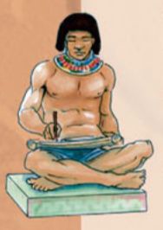
Scribes
Read and write
Recording decisions and orders of the pharaoh
Tax Records for vizier
Accounts for army

Slide 14
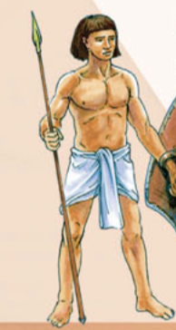
Soldiers
Professional, full-time soldiers

Slide 15
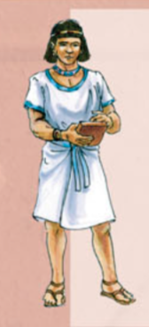
Merchants
Traded goods (linen, papyrus, grain)
Imported goods (wood, copper, animals)

Slide 16
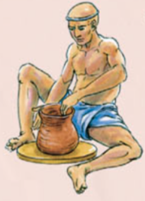
Craftsmen
Skilled Workers
Potters and Stonemasons
Necessary goods for everyday use/objects for temple

Slide 17
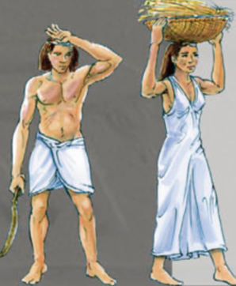
Farmers
grew crops (wheat, barley)
tended animals
building work during inundation

Slide 18
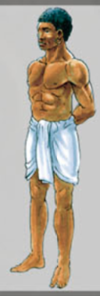
Slaves
usually foreigners (captured in war)
domestic servants, farmhands, mineworkers
some worked in pharaoh’s palace

Slide 19
ACTIVITY - Pharaohs
Get ONE (1) information sheet between 2
Read through information about the Pharaohs
Complete the following
Write the SEVEN (7) elements of a pharaoh’s clothing
Summarise the Pharaoh’s ‘Earthly Responsibilities’ and ‘Divine Responsibilities’
Define ‘Dynasty’, and explain how dynasties worked
Answer Q5 from page 229

